Slide 1
CRYPTOGRAPHY
Key Management

Slide 2
Contents
Key Management
Diffie-Hellman Key Exchange

Slide 3
Key Management
The distribution of public keys
  Public announcement
  Public available directory
  Public-key authority
  Public-key certificates
The use of public-key encryption to distribute secret keys

Slide 4
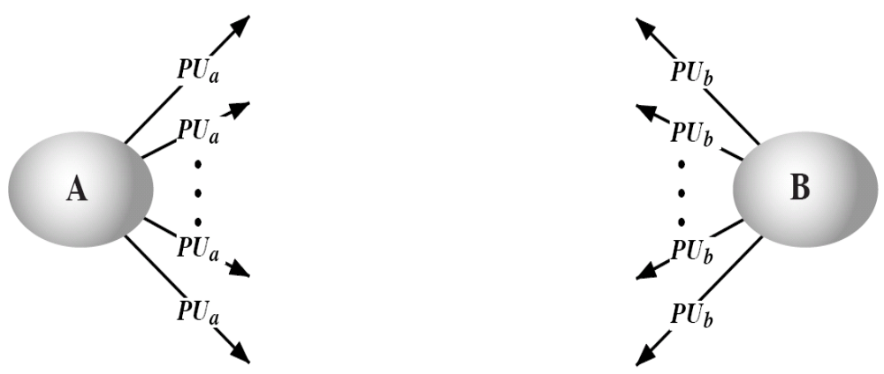
Public Announcement of Public Keys
Users distribute public keys to recipients or broadcast to community at large
  E.g., such as RSA, any participant can send his or her public key to another participant
  Major weakness is forgery
  Anyone can create a key claiming to be someone else and broadcast it
  Until forgery is discovered can masquerade as claimed user

Slide 5
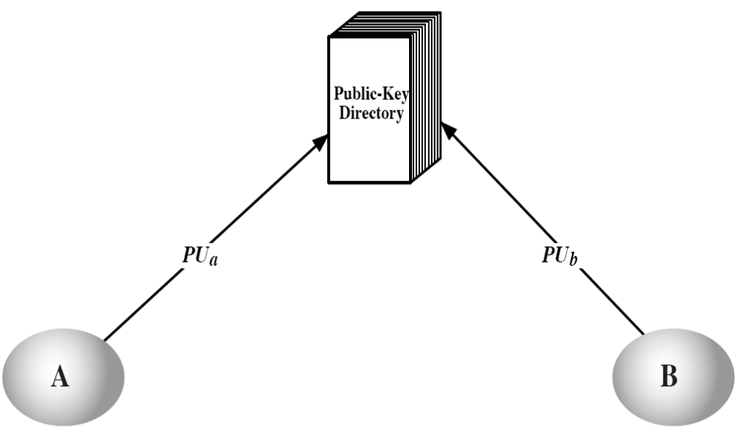
Public Key Directory
Can obtain greater security by registering keys with a public directory
Directory must be trusted with properties:
  Contains {name, public-key} entries
  Participants register securely with directory
  Participants can replace key at any time
  Directory is periodically published
  Directory can be accessed electronically
The scheme is Cleary more secure. The danger is, if an adversary succeeds in obtaining or computing the private key of the directory authority-it can impersonate public keys of all the participants-Still vulnerable to tampering or forgery

Slide 6
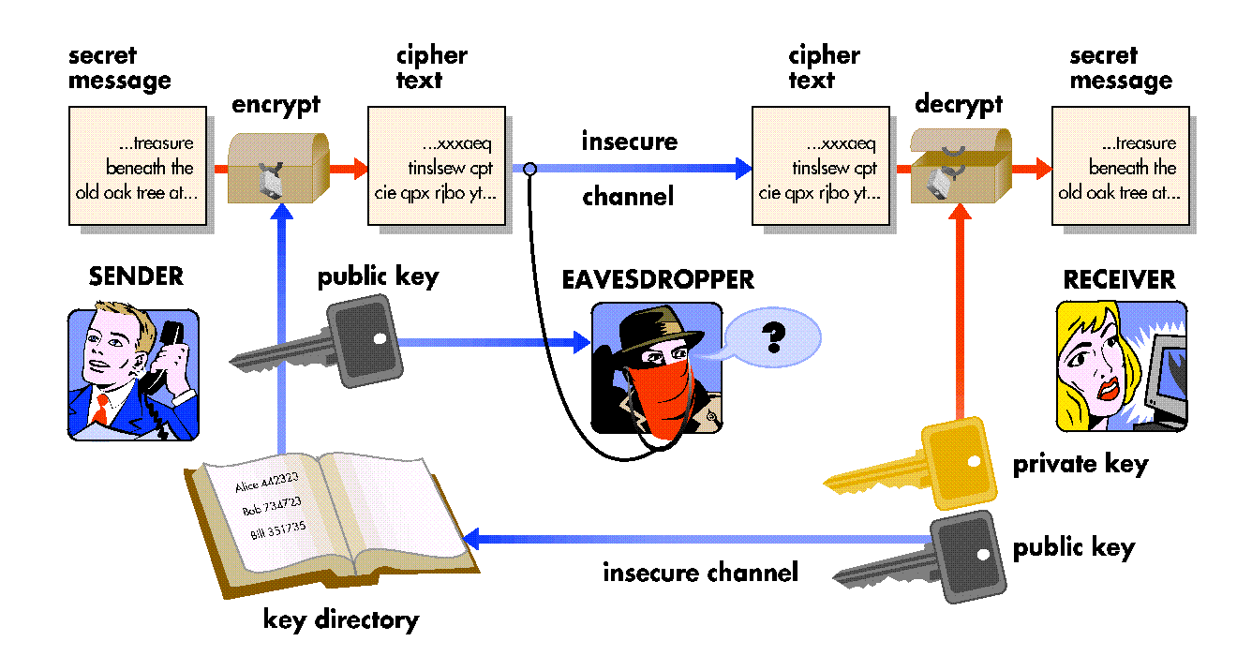
Public Key Directory

Slide 7
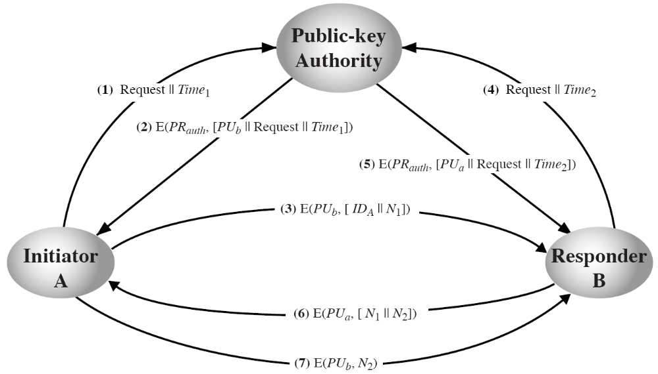
Public Key Authority
Public-Key Distribution Scenario

Slide 8
Public Key Authority
Improve security by tightening control over distribution of public keys from the directory
Has properties of directory
Requires users to know public key for the directory
Users interact with directory to obtain any desired public key securely
  Require real-time access to directory when keys are needed
Users A and B mutually authenticate and assure freshness
Drawbacks
  Public key authority could be a performance bottleneck
  The directory is vulnerable to tampering

Slide 9
Public Key Certificates
Goal is to provide a mechanism as secure and reliable as the public key authority without requiring direct contact-use of public key certificate
Public key certificate
  Binds identity to public key
  Usually with other info such as period of validity, rights of use etc.
  With all contents signed by a TTP or Certificate Authority (CA)
Public key certificate requirements
  Anyone can read a certificate and determine the name and public key of the owner
  Anyone can verify that the certificate originated from the public key certification authority
  Only the public key certification authority can issue or update certificates
  Anyone can verify the currency of the certificate

Slide 10
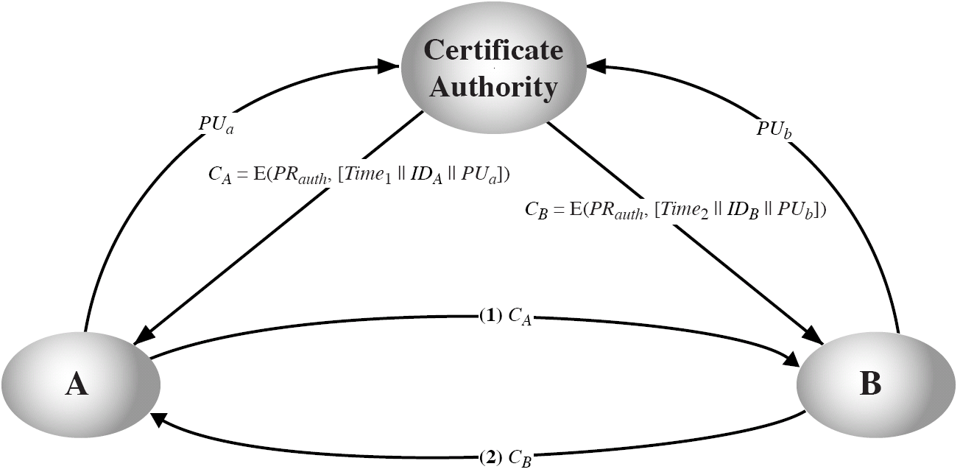
Public Key Certificates
Exchange of Public-Key Certificates

Slide 11
Distribution of Secret Keys using PKC
Because of its huge computational cost, Public-Key cryptosystem usage tends to be restricted
  Digital signatures
  Secret key distribution

Slide 12
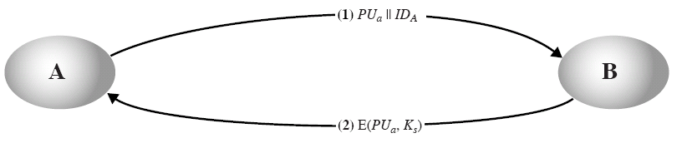
Simple Secret Key Distribution (Merkle’s)
Alice generates a public/private key pair and sends her public key to Bob
Bob generates a secret key and sends it to Alice encrypted in her public key
Simple but vulnerable to man-in-the-middle attack
  End-to-end authentication is required
Simple Use of Public-Key Encryption to Establish a Session Key

Slide 13
Secret Key Distribution (Needham-Schroeder’s)
Provides a protection against both active and passive attacks
Assume Alice and Bob have exchanged public keys (by any scheme described earlier)
Steps
  1. Alice encrypts and sends an identifier of Alice and a nonce to Bob
  2. Bob encrypts and sends Alice’s nonce and his own nonce
  3. Alice encrypts and sends Bob’s nonce back to Bob
  4. Alice selects, signs, encrypts and sends a secret key to Bob
Ensure both confidentiality and authentication in the exchange of a secret key

Slide 14
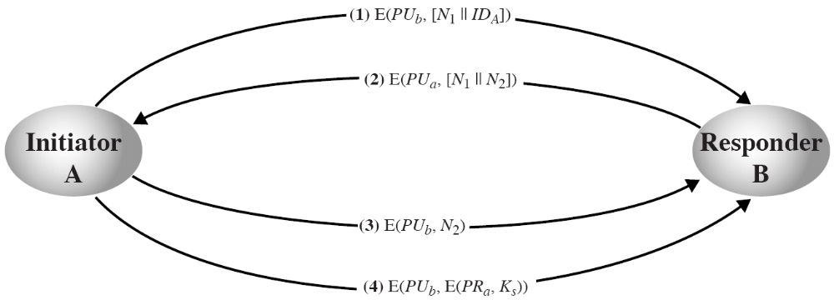
Secret Key Distribution (Needham-Schroeder’s)
Public-Key Distribution of Secret Keys (Needham-Schroeder’s Algorithm)

Slide 15
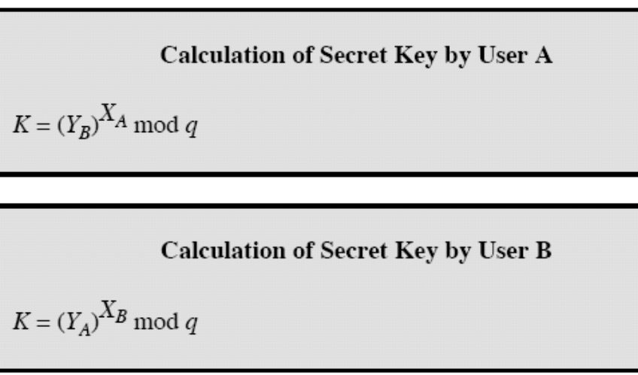
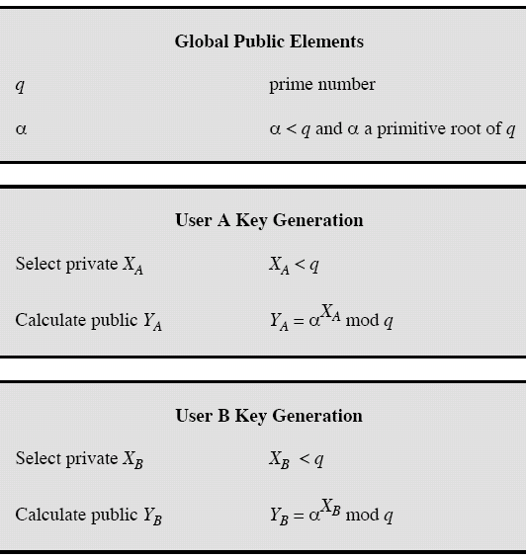
Diffie-Hellman Key Exchange
Relies on difficulty of computing discrete logarithms
K = (YB)^{XA} mod q
= (α^{XB} mod q)^{XA} mod q
= (α^{XB})^{XA} mod q
= α^{XBXA} mod q
= (α^{XA})^{XB} mod q
= (α^{XA} mod q)^{XB} mod q
= (YA)^{XB} mod q

Slide 16
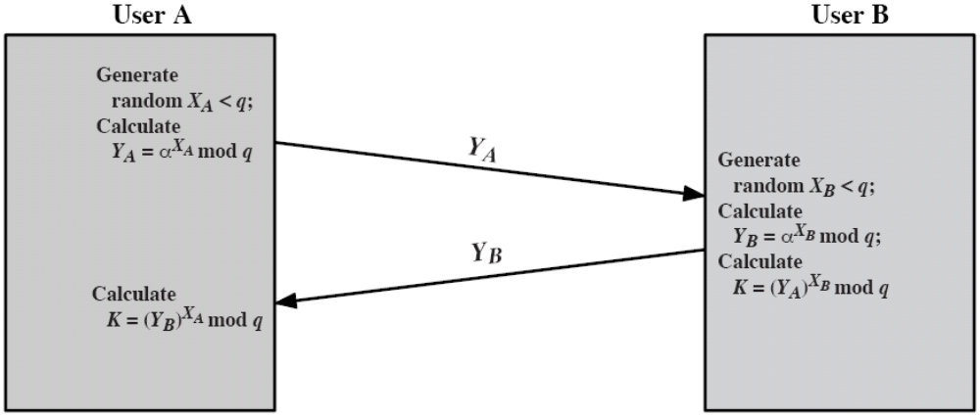
Diffie-Hellman Key Exchange
EXAMPLE:
q = 97, primitive root of q, in this case, α = 5
A and B selects secret keys XA = 36 and XB = 58
Each computes public key; YA = 5³⁶ = 50 mod 97, YB = 5⁵⁸ = 44 mod 97
After exchanging public keys, each compute the common secret key:
K = (YB)^{XA} mod 97 = 44³⁶ = 75 mod 97
K = (YA)^{XB} mod 97 = 50⁵⁸ = 75 mod 97

Slide 17
Man-in-the-Middle Attack
YA
YD1
Alice
YD2
Darth
YB
Bob
K2 = (YD2)^{XA} mod q
K1 = (YB)^{XD1} mod q
K1 = (YD1)^{XB} mod q
K2 = (YA)^{XD2} mod q
To counter such an attack, end-to-end authentication (the use of digital signatures or public-key certificates) is required

